Slide 1
Hello!
Florin Vasiliu
Casandra Carrizales
Chunyi Shi
We are here because I love to give presentations.
You can find me at Rice University DataBootcamp

Slide 2
The Relationship between Dow Jones and Gas Price

Slide 3
How Gas Prices Affect the Stock Market
Researches
Researchers at the Federal Reserve Bank of Cleveland looked at movements in the price of oil and stock market prices and discovered, to the surprise of many, that there is little correlation between oil prices and the stock market.
Studies
Their study does not necessarily prove that the price of oil has a very limited impact on stock market prices; it does suggest, however, that analysts cannot really predict the way stocks react to changing gas prices.

Slide 4
Using Python to do Data Analysis
Use Python to conduct this study
Gas Price over Time
Dow Jones over Time
Oil Price vs. Dow Correlation
Regressional Analysis

Slide 5
Use Python to conduct this study

Slide 6
In this project, we requested information set using API from EIA (U.S. Energy Information Administration) to incorporate with data sets from Yahoo! Finance to run analysis. We compared data sets of both Gas Price and Dow Jones over time to determine if correlation exists.
We used Gas Price and Dow Jones from 06/05/2000 to 03/09/2020.

Slide 7
Gas Price Over Time

Slide 8
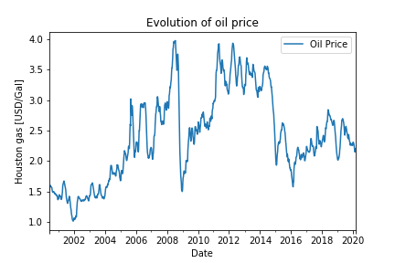
Higher gas prices affect more than just the cost to fill up at the gas station; higher gas prices have an effect on the broader economy.

Slide 9
Dow Jones Over Time

Slide 10
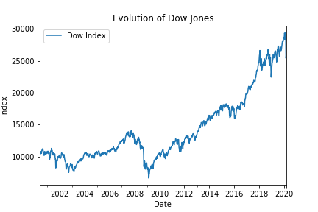
This similarity is apparent in Dow Jones prior to 2008 financial crisis.

Slide 11
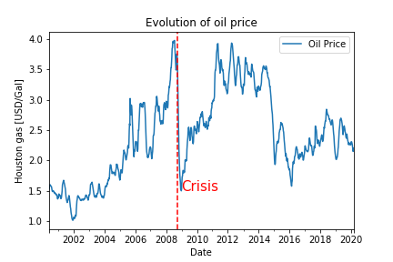
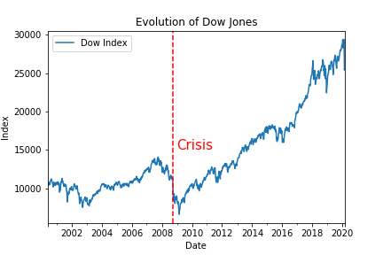
Comparison
White
Is the color of milk and fresh snow, the color produced by the combination of all the colors of the visible spectrum.
Black
Is the color of coal, ebony, and of outer space. It is the darkest color, the result of the absence of or complete absorption of light.

Slide 12
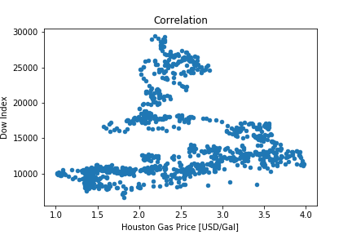
Correlation

Slide 13
Initial Conclusion
Before Crisis
It appears there is a strong correlation between two indicators before 2008 financial crisis.
After Crisis
The strength of correlation is less indicative after 2008 financial crisis.
Correlation over Time
Overtime we see both variables evolve in different ways. The change occurred after 2008.

Slide 14
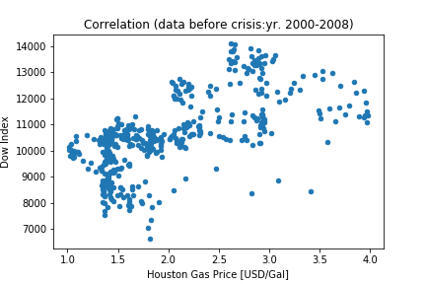
Narrowing down from the bigger picture, this is a closer look emphasizing market correlation before 2008.

Slide 15
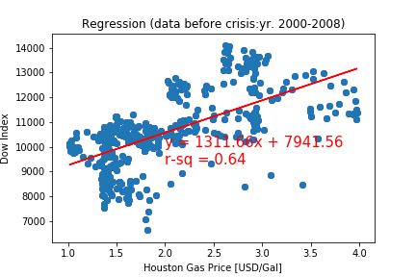
The regression line suggest there is a positive correlation between gas price and stock market.

Slide 16
0.64
Whoa! That’s a big number, do you believe it?

Slide 17
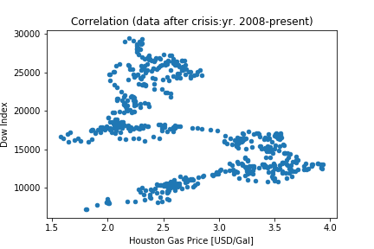
Narrowing down from the bigger picture, this is a closer look emphasizing market correlation after 2008.

Slide 18
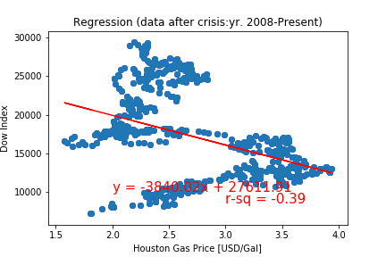
The regression line suggest there is a negative correlation between gas price and stock market.

Slide 19
-0.39
Whoa! That’s very different than the relationship before 2008 financial crisis. Do you agree?

Slide 20

Comparison
White
Is the color of milk and fresh snow, the color produced by the combination of all the colors of the visible spectrum.
Black
Is the color of coal, ebony, and of outer space. It is the darkest color, the result of the absence of or complete absorption of light.

Slide 21
Reasons:
185,244 users
100%
That’s a lot of money
And a lot of users
Total success!

Slide 22
Let’s review some concepts
Yellow
Is the color of gold, butter and ripe lemons. In the spectrum of visible light, yellow is found between green and orange.
Blue
Is the colour of the clear sky and the deep sea. It is located between violet and green on the optical spectrum.
Red
Is the color of blood, and because of this it has historically been associated with sacrifice, danger and courage.
Yellow
Is the color of gold, butter and ripe lemons. In the spectrum of visible light, yellow is found between green and orange.
Blue
Is the colour of the clear sky and the deep sea. It is located between violet and green on the optical spectrum.
Red
Is the color of blood, and because of this it has historically been associated with sacrifice, danger and courage.

Slide 23

Thanks!
Any questions? You can find me at @username & user@mail.me

Slide 24
Credits
Special thanks to all the people who made and released these awesome resources for free:
Presentation template by SlidesCarnival
Photographs by Unsplash

